Slide 1
Proposal Talk 02.10.2017
Ioannis Agalliadis Institute of Medical Informatics, Uniklinik RWTH Aachen

Slide 2

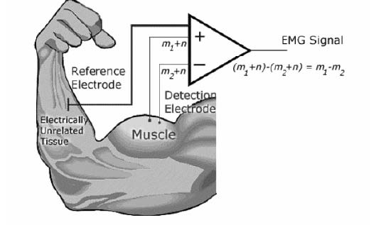
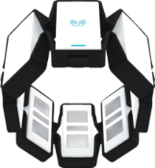
Motivation
MediWeCo: Contribution to learning and teaching physiotherapy through feedback.
First to use combination of Myo & EMG signals.
Notes:
-Contribute to MediWeCo project in order to refine the detection of the little finger movements in order to give constructive feedback to teaching and learning of physiotherapeutic skills.
-First to detect finger gestures with Myo and EMG signals.

Slide 3
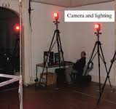
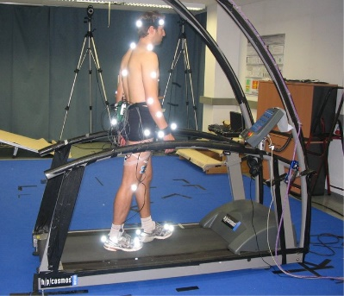
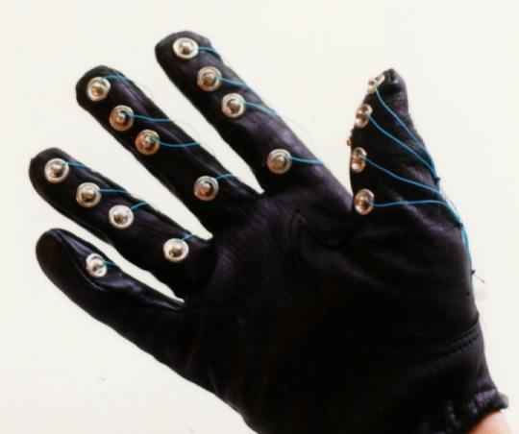
Gesture recognition?
Image analysis requires ...
Motion capture requires ...
Sensing gloves are expensive.
$$$
Notes:
-good and steady lighting conditions and lots of space
-cost of the software, equipment and personnel required can potentially be prohibitive

Slide 4
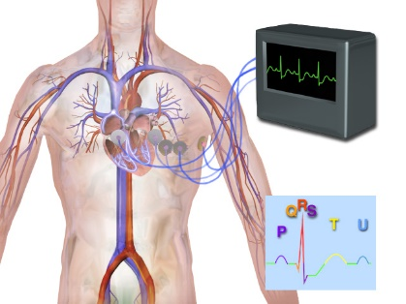
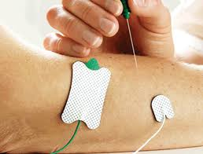
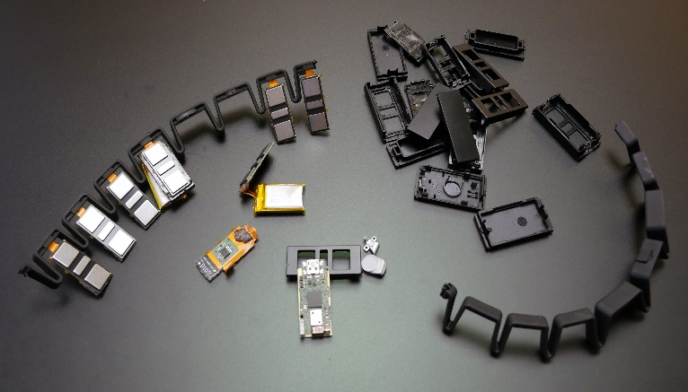
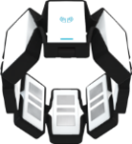
Why electromyography?
Measuring muscle activity
Thalmic Myo
Safe, easy, cheap, non-invasive
No gel to facilitate conductivity
Wireless
Notes:
There are two kinds of EMG: surface EMG and intramuscular EMG.
Myo has: 8 EMG electrodes and in each cubbie there is a small circuit board, and there are two batteries tucked in different cubbies.
On the front of the main board we found a Kinetis Cortex M4 120MHz processor, a NRF51822 bluetooth low energy tranceiver/processor under a can, and a vibration motor.
On the back there's a motion sensor.

Slide 5
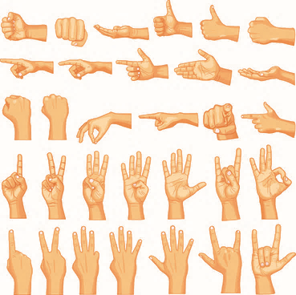
Goal: finger gesture recognition with Myo
For different finger gestures find best detection accuracy.
Signals acquired with Myo.
Focus solely on EMG signals.
Notes:
Determine the best combination of features -> best detection accuracy among the different finger gestures.
Due to the fact that for the experiments finger gestures will be examined, the hand of the subject will not be moved, will remain still, so no IMU data will be needed. So, I will focus only on acquiring EMG signals from Myo.

Slide 6
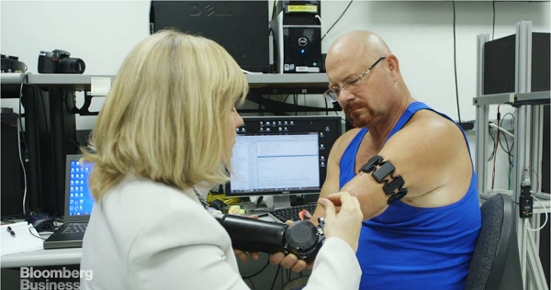
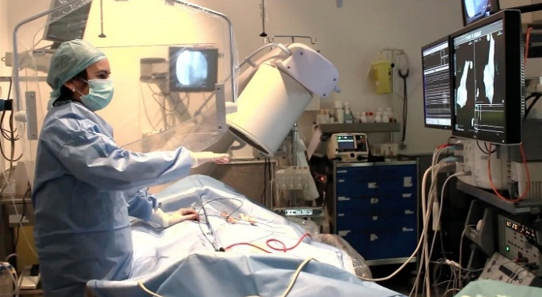
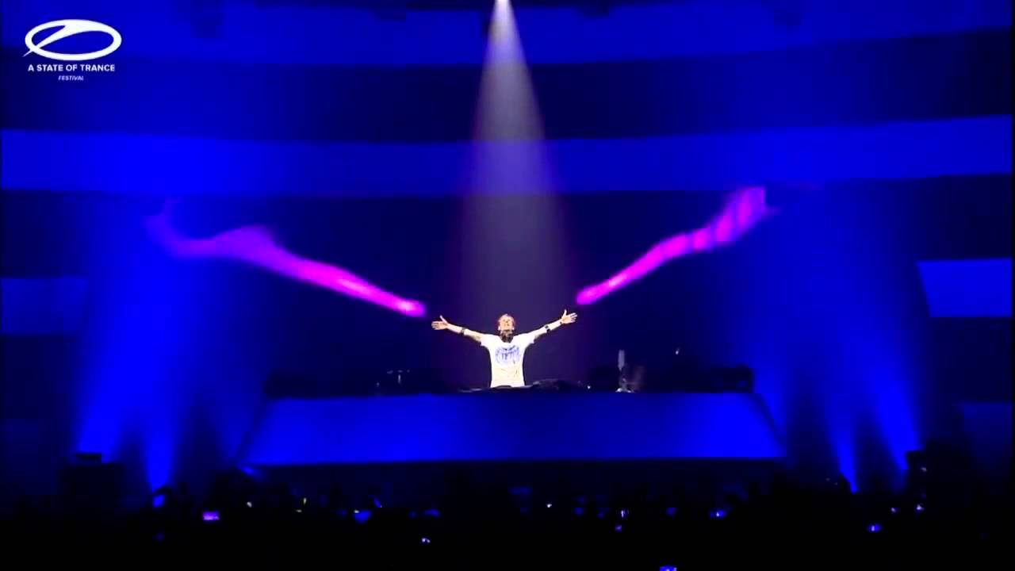
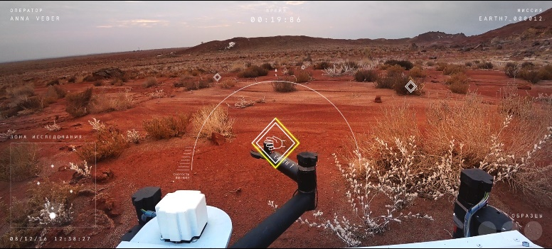
State of the art
Robotic arm control
Surgery interface control
Control of stage effects
Remote vehicle control
Notes:
-There is a prosthetic arm attached directly to his skeleton, and uses two Myo armbands on his upper arm to detect the electrical activity of his muscles. When he thinks about moving his prosthetic hand, he is able to do it.
-Myo is being used by surgeons in Spain to navigate through medical records while in the middle of surgery
-Armin van Buuren controlled the stage effects during his performance such as control stage lights in real time with his hands
- Erth7 is a game where the user could remotely manoeuvre a vehicle with simple gesture recognition and explore the remote secret location thousands of miles away where the vehicle was situated.

Slide 7
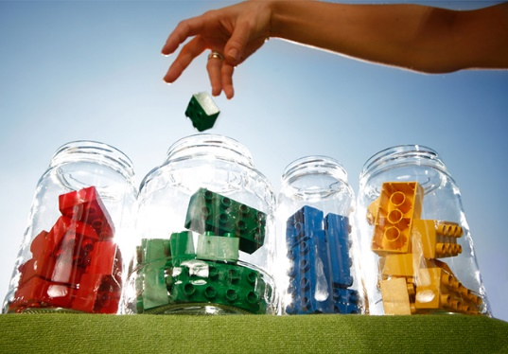
Methods
EMG signals and video (thumb flexion/extension) acquired with Myo
Removal of artifacts
Segment the signal into individual movements
Division of data into train, test and evaluation folds
Windowing
Extracted features:
RMS
STFT
Moving average
Wavelet transforms
Classifiers:
kNN
SVM
ANN
Notes:
I remove

Slide 8
Methods
EMG & video acquired with Myo
Artifacts removal
Segment signal into individual movements
Divide data into 11 folds
Windowing
Feature extraction
Classification
Detection accuracies

Slide 9
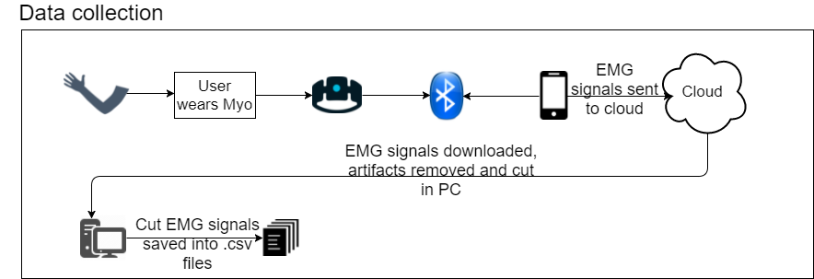
Tasks

Slide 10
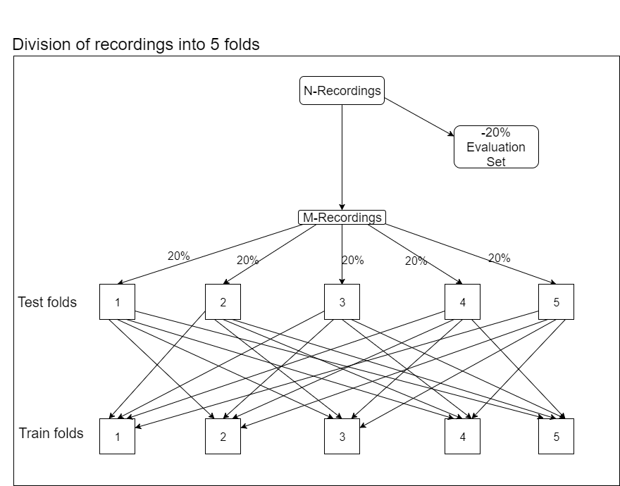
Tasks

Slide 11
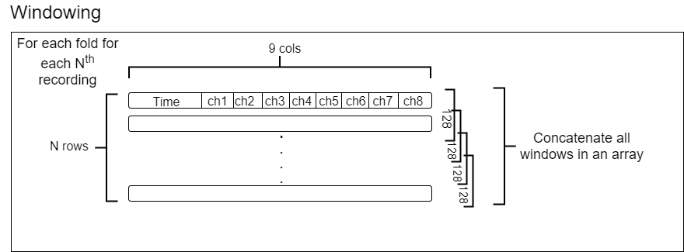
Tasks

Slide 12
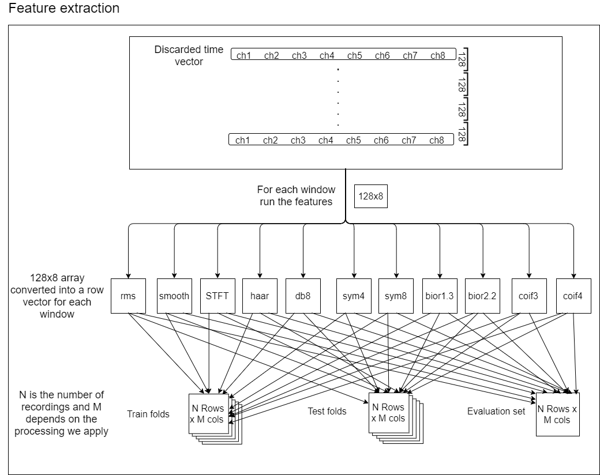
Tasks

Slide 13
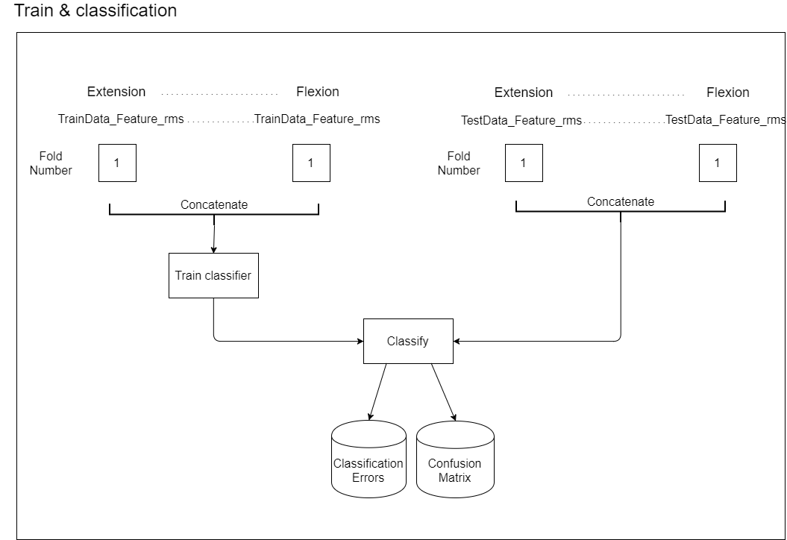
Tasks

Slide 14
Timeline
Combine most accurate Features -> Results
11/2017 – 12/2017
Test forward selection &
backward elimination, creation of new gesture database
12/2017 - 01/2018
Acquire new EMG signals
01/2017 - 03/2018
Discussion & Conclusion
03/2018 - 03/2018
Thesis Registration
Project Hand-Off
12/2017
03/2018
2017
Dec
Jan
Feb
Mar
2018

Slide 15
Summary
What I will do
Test new finger gestures.
Find the optimal parameters for the classifiers.
Combine the best feature sets to increase the detection accuracies.
Create new finger gesture database.

